Slide 1
Global Marketplace Ecommerce
Name-Riya Gupta
Reg. no.:-12205884
Presentation
On

Slide 2


Table Of Content
T
Introduction of course
Modules
Project
Interface Design
Certificate
Conclusion

Slide 3
Introduction
Web development is the work involved in developing a Web site for the Internet (World Wide Web) or an intranet (a private network). Web development can range from developing a simple single static page of plain text to complex Web-based Internet applications (Web apps), electronic businesses, and social network services. A more comprehensive list of tasks to which Web development commonly refers, may include Web engineering, Web design, Web content development, client liaison, client-side/server-side scripting, Web server and network security configuration, and e-commerce development.

Slide 4
Module of course
HTML
CSS
JAVASCRIPT

Slide 5
Module Description
HTML: The Hyper Text Markup Language or HTML is the standard markup language for documents designed to be displayed in a web browser.
CSS: Cascading Style Sheets is a style sheet language used for describing the presentation of a document written in a markup language.
Java script: JavaScript, often abbreviated as JS, is a programming language that is one of the core technologies of the World Wide Web, alongside HTML and CSS.

Slide 6
About Project
A website that allows people to buy and sell physical goods, services, and digital products over the internet rather than at a brick-and-mortar location. Through an e-commerce website, a business can process orders, accept payments, manage shipping and logistics, and provide customer service.

Slide 7
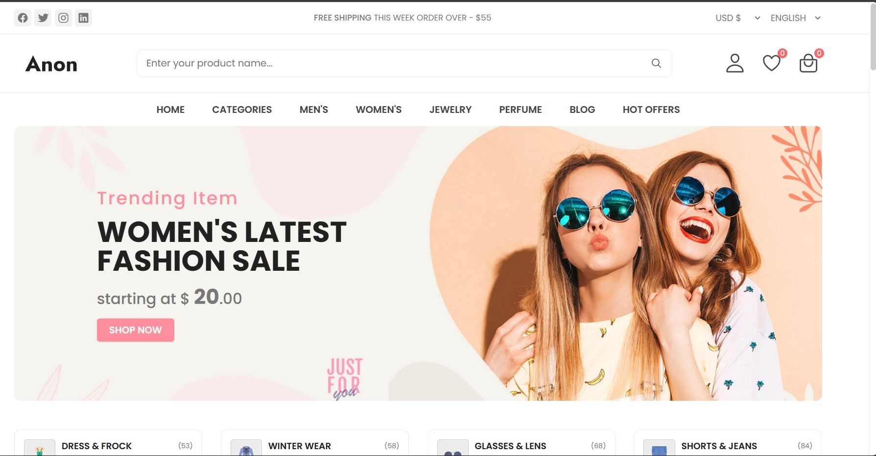
Interface Design
“
”

Slide 8


Interface Design
​

Slide 9
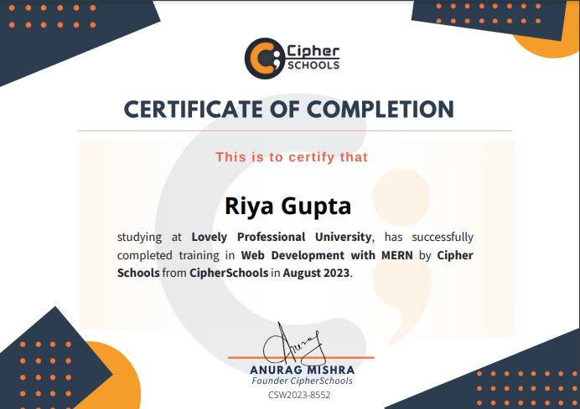
Certificate

Slide 10
Conclusion I have tried to develop a e-commerce website that can be useful in the way that is make easier way to buy products and to save time. Despite all my efforts there may be some bugs in the system, which are still to be removed. This is possible by the testing being done in the system. I have left all the options open so that if there is any other future requirement in the system by the user for the enhancement of the system then it is possible to implement them. In last I would like to thanks all the persons involved in the development of the website directly or indirectly. It is useful in the way that is making easier way to buy products.
C

Slide 11
Thank you

